Slide 1
KOREF T2T assembly without ultra-long reads failed
Changhan Yoon
2023.12.08

Slide 2
Abstract
During the course, the reference genome became the most important to understand evolutionary theories, Genomics, Epigenomics, Transcriptomics, Canceromics, Diagnomics and Geromics.
The goal of this study is to enhance the low resolution of the KOREF assembly in heterochromatin regions.
However, we lack ultra-long reads for the T2T genome assembly.
A recent study introduced a method for T2T genome assembly without ultra-long reads.
Although we applied this method, the results were incongruent, likely attributed to higher amounts of repetitive regions in human Y chromosome and the relatively shorter N50 length of our reads (10~15 kb < 17 kb).
In conclusion, ultra-long reads (>100 kb) are critical for achieving a T2T KOREF genome assembly.

Slide 3
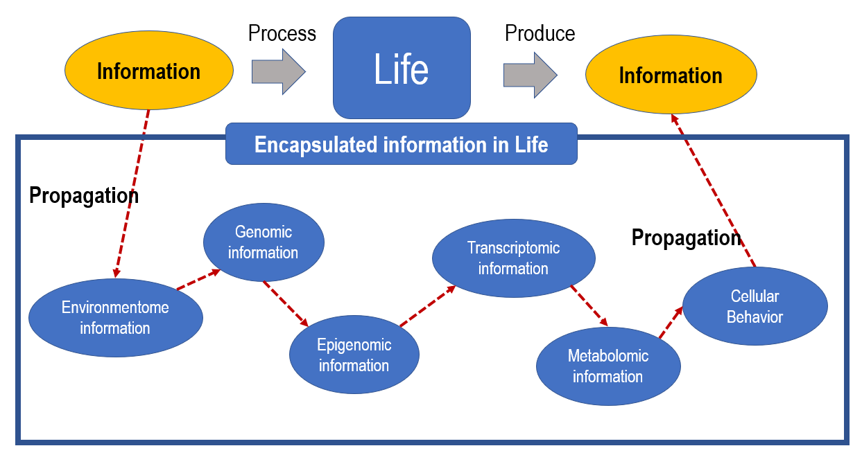
Without the reference genome, understanding information propagation is impossible.

Slide 4
Background
Many heterochromatic regions of the genome are missing from even the best genome assemblies because repetitive reads also present a challenge to genome assemblers (Treangen and Salzberg 2011).
Satellite array sizes can vary between individuals over an order of magnitude (7 to 98 Mb) and array sizes are distributed differently within distinct Y haplogroups (Altemose et al., 2014).
Human chromosome Y’s highly repetitive centromere DNA (365 kb) was assembled (Jain et al., 2018).
Used 8 extremely accurate (99.4~99.8%) ultra-long reads (150 ~ 209 kb)
T2T

Slide 5
A trial to build a T2T genome without ultra-long reads
Drosophila’s chromosome Y (40 Mb) which is entirely heterochromatic was resolved (Chang and Larracuente, 2019)
PacBio Read N50 : 17 kb
Our long read (PacBio & ONT) N50: 10~15kb

Slide 6
Method to assemble (not ultra) long reads to get a heterochromatin assembly
Minimap2

Slide 7
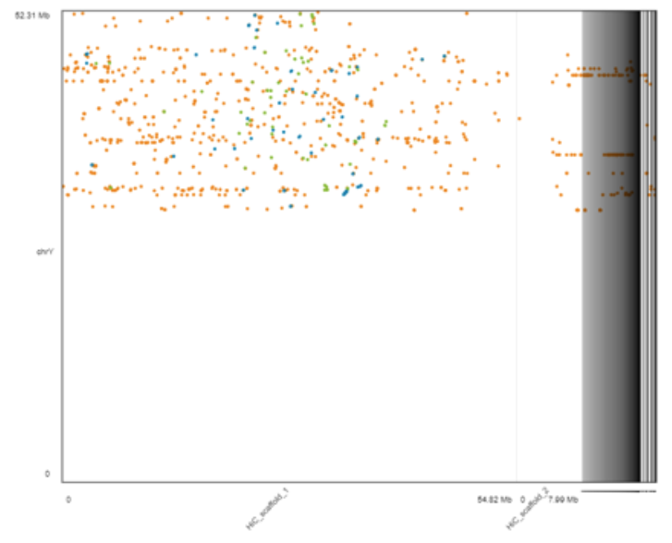
Results: No concordance with existing KOREF assembly
Expected alignment
KOREF Y chromosome (52.31 Mb)
Heterochromatin
Heterochromatin
putative Y chromosome assembly (54.82 Mb)

Slide 8
Limitations
Assessment
Gene/repeat annotations are not performed yet.
Method
Low mapping rate (0.7%)
Reference
KOREF Y chromosome’s low contiguity and accuracy

Slide 9
Summary
The goal is to enhance the low resolution of the KOREF assembly in heterochromatin regions.
However, we lack ultra-long reads for the T2T genome assembly.
A recent study introduced a method for T2T genome assembly without ultra-long reads.
Although we applied this method, the results were incongruent, likely attributed to higher amounts of repetitive regions in human Y chromosome and the relatively shorter N50 length of our reads (10~15 kb < 17 kb).
In conclusion, ultra-long reads (>100 kb) are critical for achieving a T2T KOREF genome assembly.

Slide 10
SELF (Self evaluation learning framework)
1. Do I love/like the subject? Yes
2. Attendance 9/14
3. Did I think of questions out of my own logical ramifications? Yes
4. Did I write many scientific reports? No
5. Did I develop my own ideas? Yes
6. Was this course helpful to my own research? Yes
7. Did I present anything in the class? Yes
8. Did I make the class more exciting by active participation? Yes
9. Is my communication in the subject field improved? Yes
10. Is my Enlgish writing skill suitable for a colleage student? No
Score: 7/10 B+

