Slide 1
Cancer: Genomics of metastasis

Slide 2
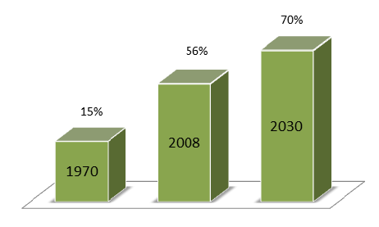
The Connection Between Cancer and DNA
One person dies from cancer each minute in the United States. That’s 1,500 deaths each day. As the population ages, this number is expected to increase.
Cancer-causing changes in DNA, mutations, can be inherited, but most are acquired throughout life. They may be caused by environmental factors, such as chemicals, or from lifestyle choices, such as smoking.
Notes:
We need to understand cancer to control and ultimately conquer it. Many scientists are working hard to attack cancer where it starts — in our DNA.
DNA, which stands for deoxyribonucleic acid, is the chemical carrying
instructions that tell cells what to do. When those instructions have
mistakes, cells may not function normally, including growing out of control to cause cancer.

Slide 3
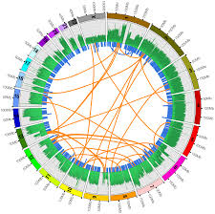
What is Cancer Genomics?
In cancer cells, small changes in the genetic letters can change what a genomic word or sentence means. A changed letter can cause the cell to make a protein that doesn’t allow the cell to work as it should.
By studying the cancer genome, scientists can discover what letter changes are causing a cell to become a cancer.

Slide 4
Cancer cells that invade other parts of the body do so by accumulating genomic aberrations. Analysis of the genomic differences between primary and metastatic tumors should aid the understanding of this process.

Slide 5
Massively parallel sequencing technologies
next-generation sequencing (NGS) or second-generation sequencing
Steps:
1) DNA sequencing libraries are generated by clonal amplification by PCR in vitro.
2) the DNA is sequenced by synthesis (addition of nucleotides to the complementary strand)
3) the spatially segregated, amplified DNA templates are sequenced simultaneously in a massively parallel fashion (fluorescently labeled dNTP is used for sequencing)

Slide 6
Massively parallel sequencing technologies

Slide 7
Massively parallel sequencing technologies (cont)
sufficiently powerful and cost-effective to allow high-resolution analysis of changes that occur in the genome of patients with cancer
variations in the number of copies of specific genomic regions, changes in DNA sequence, and structural aberrations

Slide 8
Research Article:
Ding et al: analyzed the genomic features of primary and metastatic tumor samples from a 44-year-old African-American patient with basal-like breast cancer.
How cancer genomes evolve as the disease progresses.

Slide 9
tumor cells escape their primary site and colonize other locations in the body — often with lethal results
biological changes:
variations in cell differentiation
in the ability to sense cell-death signals
in cell-cycle regulation
in genome stability
increased cell motility and invasion
new blood-vessel formation and inflammation

Slide 10
Breast cancer: absence of the ERBB2 protein and of estrogen and progesterone receptors
Notes:
the authors took a biopsy from the patient's breast tumor — and a blood sample as a normal control — at the time of initial surgery (Fig. 1). They also introduced cells from this biopsy into an immunodeficient mouse to produce a xenograft tumor. Eight months later, despite chemotherapy, the cancer had spread to the patient's brain, from which the authors also obtained a sample. They then performed whole-genome sequencing on all four samples — the patient's primary and secondary tumors, the mouse xenograft tumor and the patient's blood sample — to search for structural rearrangements in the genomes, abnormalities in the copy number of genomic regions, and mutations.

Slide 11
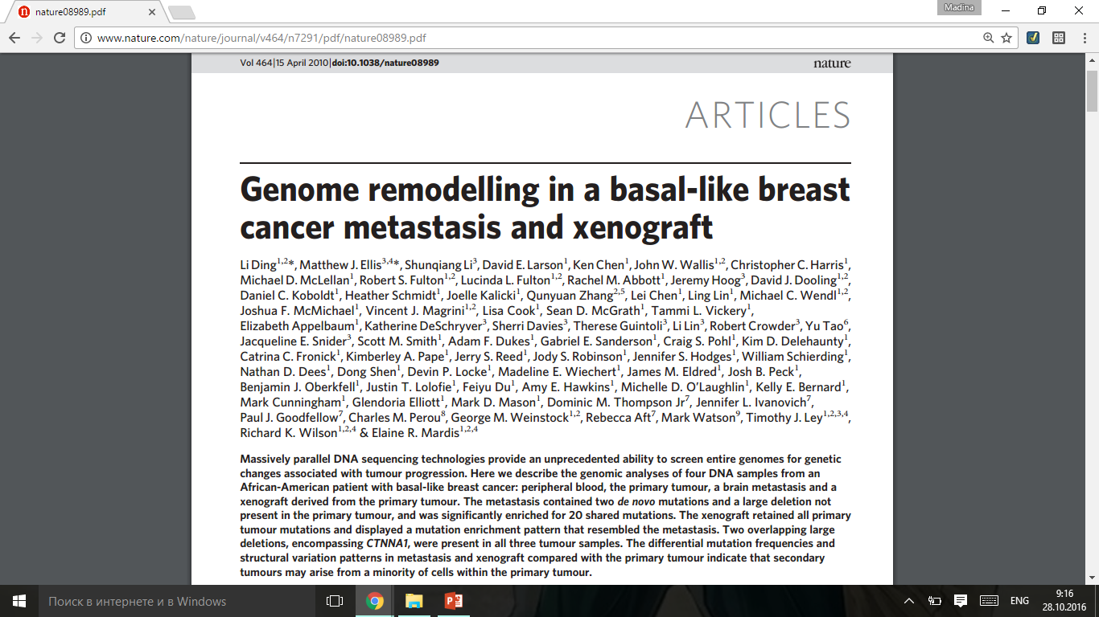
GENOME REMODELLING IN A BASAL-LIKE BREAST CANCER METASTASIS AND XENOGRAFT

Slide 12
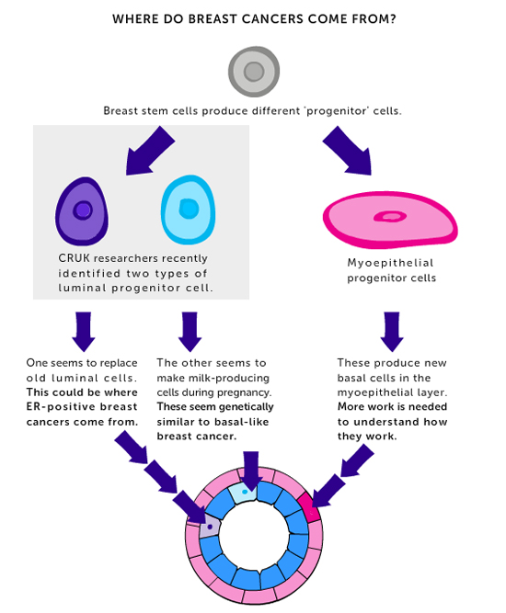
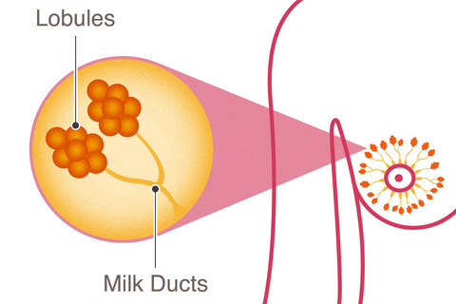
About Breast Cancer
Basal-like breast cancer is characterized by the absence of oestrogen receptor (ER) expression, the lack of ERBB2 gene amplification, and a high mitotic index

Slide 13
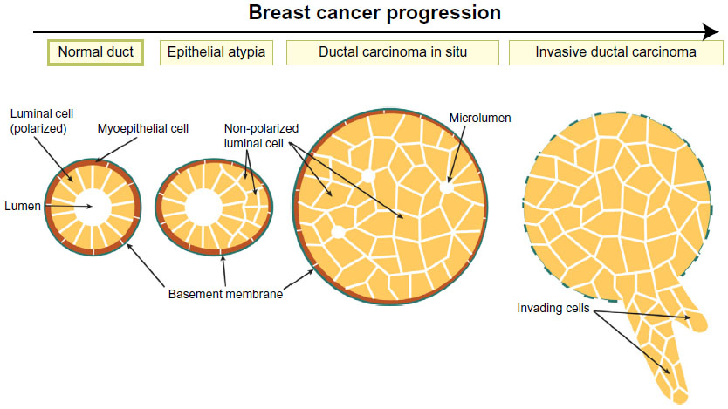
Cross-section of a duct shows loss of epithelial integrity and ductal filling across the different stages of breast cancer.
Notes:
The disease also accounts for an elevated percentage of breast cancers in patients with African ancestry

Slide 14
The fatal metastatic process is driven by mutations that occur after the tumor cells arrive at the distant site
?
The primary tumor generates cells with a complete repertoire of somatic mutations required for metastatic growth

Slide 15
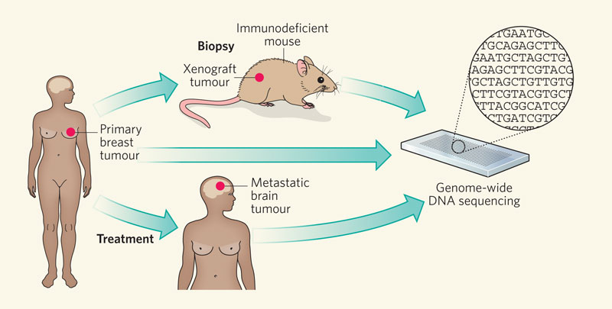
COVERING ALL THE BASES IN METASTATIC ASSESSMENT
Notes:
*A transplantable humanin-mouse (HIM) xenograft tumour line was generated from a sample of her primary tumour biopsied before treatment

Slide 16
Sequence coverage and mutation analysis
comparing single nucleotide variants (SNVs) detected by MAQ5 with single nucleotide polymorphisms (SNPs) genotyped using Illumina 1M duo arrays for all tissues excluding the xenograft.
Notes:
A 44-year-old African-American woman was diagnosed with an ERBB2-negative and ER-negative inflammatory breast cancer.
*Using a paired-end sequencing strategy
*

Slide 17
The mapping rates of NOD/SCID data to human and mouse C57BL/6 reference sequences were 3.17% and 95.85%, respectively.
On the basis of pathology review, the tumour cellularity estimates were 70% for the primary tumour and 90% for both the brain metastasis and xenograft.
A total of 50 somatic sites, including 28 missense, 11 silent, 2 splice site, 1 RNA, 1 nonsense, 4 insertions and 3 deletions, were validated in at least one of the three tumour genomes.
Notes:
The SCID mutation has been transferred onto a non-obese diabetic background. Animals homozygous for the SCID mutation have impaired T and B cell lymphocyte development. The NOD background additionally results in deficient natural killer(NK)cell functio

Slide 18
The process for selecting somatic mutations
Notes:
*Putative somatic SNVs and indels that overlap with coding sequences, splice sites and RNA genes were included as ‘tier 1’

Slide 19
For many of our cancer papers, we subdivide the human genomes into tiers and categorize somatic mutations by which tier they fall in:
Tier 1: all variants in the coding regions of annotated exons, canonical splice sites, and RNA genes.
Tier 2: all variants in conserved genomic regions and all variants in regulatory non-repeat masked regions annotated by UCSC annotation.
Tier 3: variants in non-repeat masked regions
Tier 4: all remaining snvs
Notes:
*on-line genome browser hosted by the University of California, Santa Cruz (UCSC).It is an interactive website offering access to genome sequence data from a variety of vertebrate and invertebrate species and major model organisms, integrated with a large collection of aligned annotations

Slide 20
Mutation spectrum in basal breast tumor
Notes:
55% (22 out of 40) of coding point mutations represent C*G->T*A transitions.
*small-cell lung cancer cell line NCI-H2097
*melanoma cell line COLO-8298
*This is consistent with the higher A*T content in non-coding sequences than in coding sequences.
*e three classes of guanine mutations occurring at CpG dinucleotides in primary tumour, brain metastasis and xenograft and found that the frequencies of GRA mutations are 27.54%, 27.60% and 28.05% in each respective tumour

Slide 21
Distribution of mutations among tumors
Of the 50 validated point mutations and small indels, 48 are detectable in all three tumors
These 48 sites consist of:
20 sites with relatively comparable frequencies across tumors
26 sites significantly enriched (false discovery rate (FDR) # 0.05) in the metastasis and/or xenograft
two sites with significant enrichment (FDR # 0.05) in the primary tumor
Notes:
The mutant allele frequency of each somatic mutation is shown. Each bar represents the average of the frequency yielded by the two technologies for a single primer pair and the error bars represent the standard deviation. Data were considered only if there were at least 200 reads from Illumina sequencing and at least 20 reads from 454 sequencing.

Slide 22
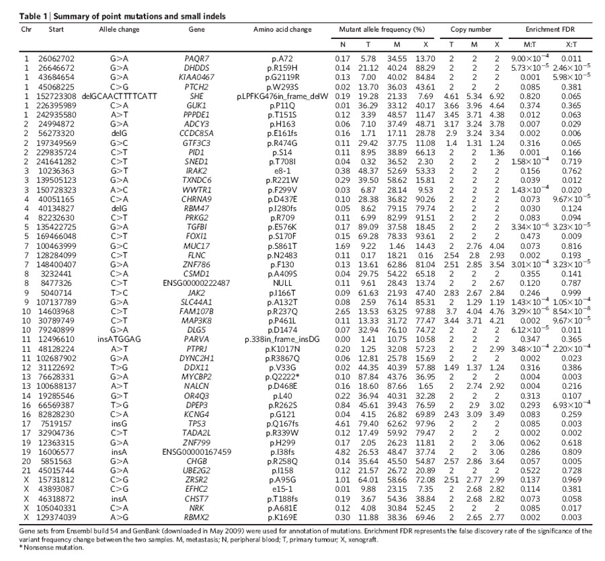
Mutations highly enriched in metastasis and/or xenograft
De novo mutations identified in the metastasis (missense mutation SNED1, with a mutant allele frequency of 37%; the other was a silent mutation (N2483) in FLNC).
Elevated copy number alterations in metastasis and xenograft

Slide 23
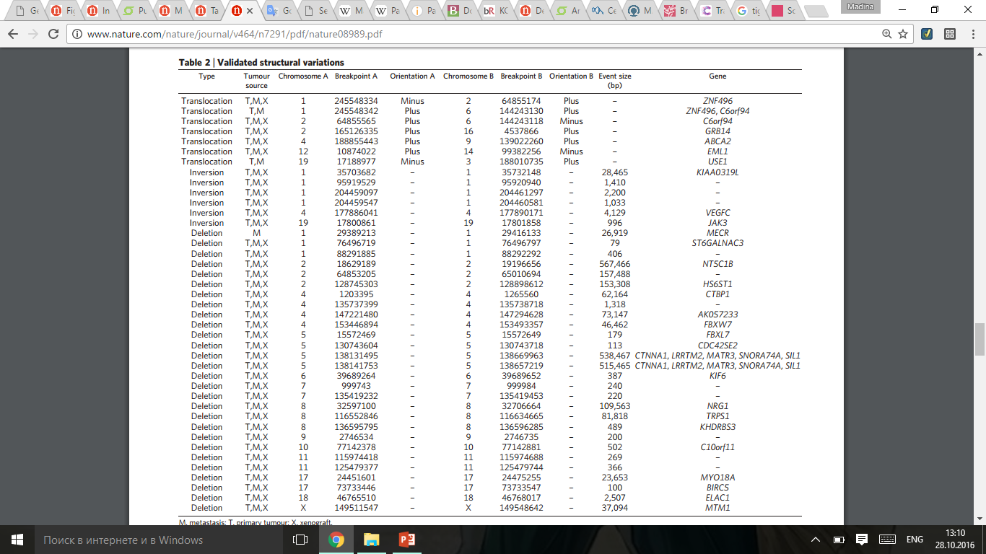
Common and unique structural variations in three tumors

Slide 24
Discussion
Identified 50 novel somatic point mutations and small indels in coding sequences, RNA genes and splice sites as well as 28 large deletions, 6 inversions and 7 translocations.
The mutation frequency range narrowed in brain metastasis and xenograft => the metastatic and transplantation processes selected for cells carrying a distinct subset of the primary tumor mutation repertoire.
The overlap between the mutation frequency changes seen in the metastatic and xenograft samples argues that cellular selection during xenograft formation is similar to that during metastasis.
The first completed basal-like breast cancer genome is highly complex, this cancer genome, in comparison with the two AML (acute myeloid leukemia) revealed a 3–4-fold increase in high confidence SNVs genome-wide, suggesting a much greater background mutation rate.

Slide 25
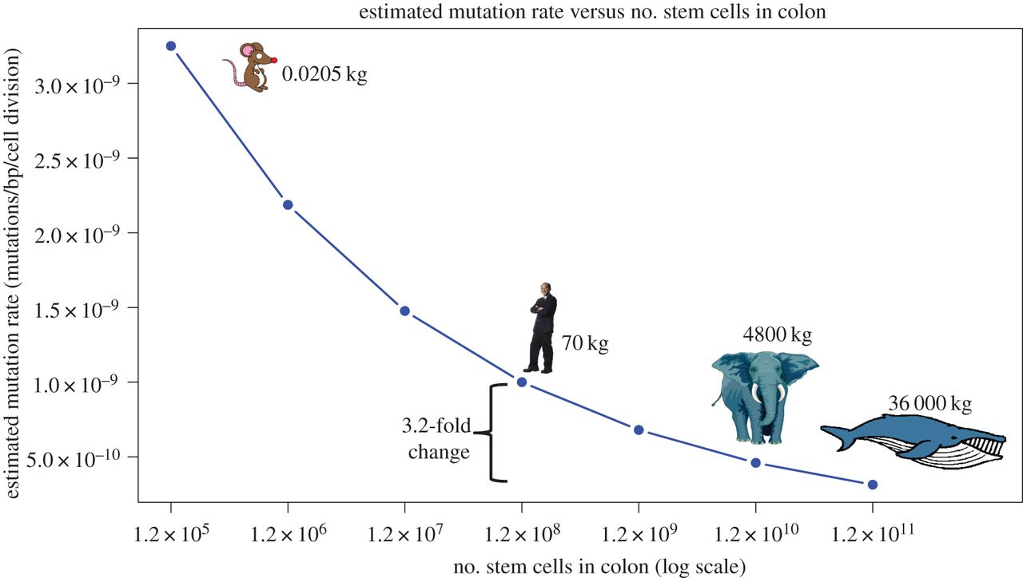
OUR thoughts
A transplantable human-in-mouse xenograft tumor presenting similar results with a brain metastasis, what kind of information will we get if we used large-scale animals?
Notes:
Estimated somatic mutation rates scaling with size. Mutation rate estimates show that a 3.2-fold decrease enables an animal that is 1000× larger (and so with 1000× more stem cells) than a human to have the same cancer risk. The mutation rates shown in the plot resulted in cancer risk predictions for the given number of cells that best matched the estimates for human (i.e. 1.2 × 10⁸ colonic stem cells) using the Calabrese–Shibata algebraic model.

Slide 26
References:
Ding, L. et al. Nature 464, 999–1005 (2010). “Genome remodelling in a basal-like breast cancer metastasis and xenograft”
Joe Gray, “Cancer: Genomics of metastasis” Nature 464, 989-990 (15 April 2010)
http://genome.wustl.edu/articles/detail/tgi-tier-annotation/
“Tracing the roots of breast cancer” (February 19, 2013) Emma Smith http://scienceblog.cancerresearchuk.org/2013/02/19/tracing-the-roots-of-breast-cancer/#wkFryBWp56qbiyWW.99

Slide 27
Thank you!

