Slide 1
5th generation sequencing
정영광 박성언

Slide 2
Content
1. Introduction
2. Design sequencing

Slide 3
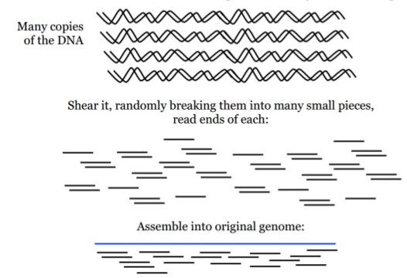
Introduction
1st(sanger sequencing)
2nd
ddNTP

Slide 4
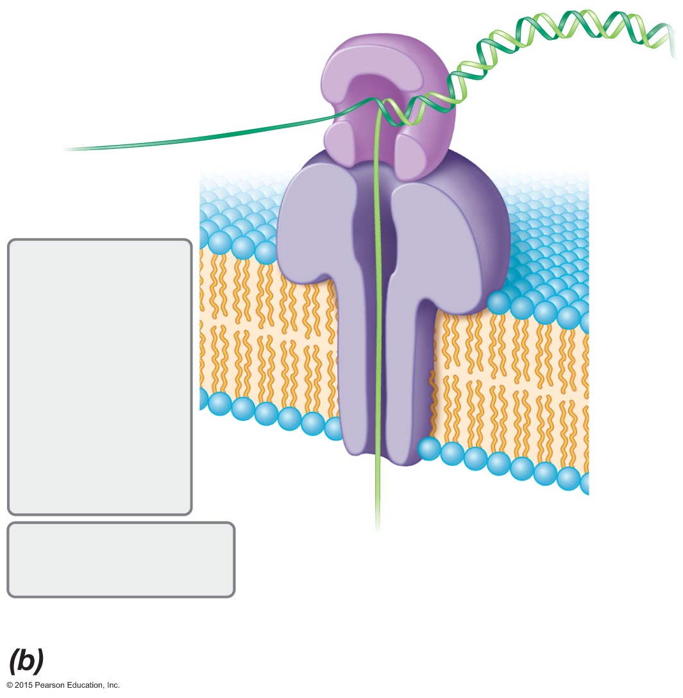
Introduction
3rd
4th
5th

Slide 5
Third generation sequencing
Single molecule sequencing
->Not use ddNTP and shotgun sequencing

Slide 6
Third generation sequencing
Pacific Bioscience SMRT(single molecule real time) sequencing

Slide 7
Forth generation sequencing
Post light sequencing
-> Optical detection is no used

Slide 8
Forth generation sequencing
Nanopore sequencing
Double-stranded DNA
Protein nanopore
base-specific
electrical charges
Single-
stranded
DNA

Slide 9
Design of sequencing
<Idea>
- Single molecule (3rd)
- Not using optical detection (4th)

Slide 10
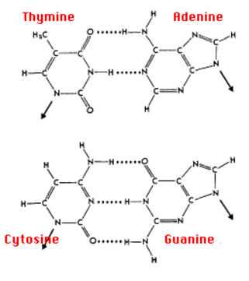
Design of sequencing
<Idea>
- The number of H-bond is different

Slide 11
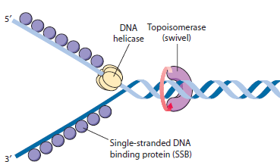
Design of sequencing
1. Nanosensor
A-T
G-C

Slide 12
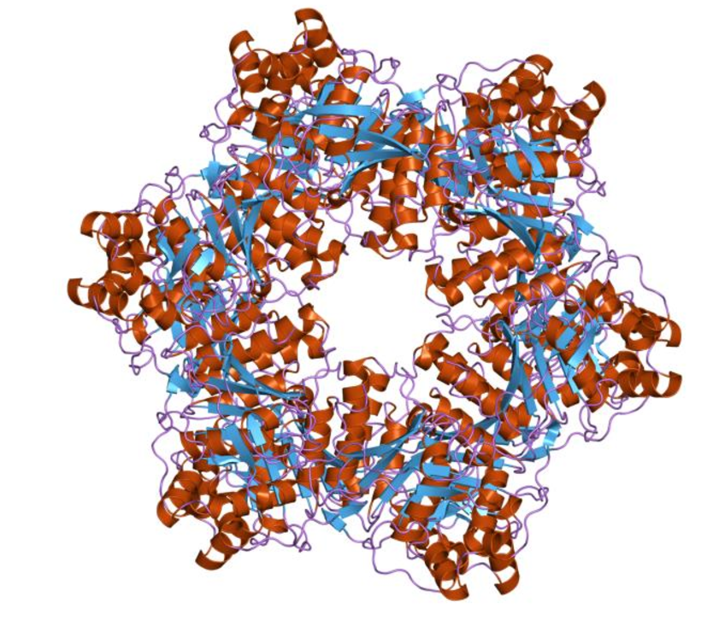
Design of sequencing
1.
Electrical field
-> measure change of current according to size (pyrimidine and purine)

Slide 13
Limitation
There is no machinery knowledge
-> We can`t find how to realize the nanosensor.

Slide 14
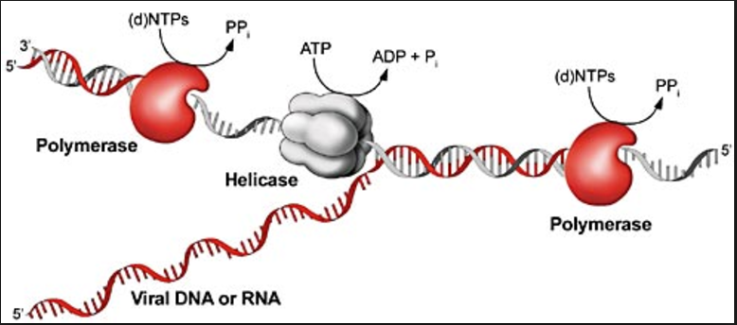
Design of sequencing
2.
Use helicase in limited ATP condition!
>measure and comparison amount of decreasing ATP
of increasing ADT and Pi
출처 https://journals.prous.com/journals/servlet/xmlxsl/pk_journals.xml_summary_pr?p_JournalId=3&p_RefId=401&p_IsPs=Y

Slide 15
Limitation
>Is it possible to MEASURE or COMPARISON amount of ATP?
-When helicase break H-bond, we can detect or measure amount of changing value?
-When helicase break H-bond, different ATP is used in double bond and triple bond?
-How do you distinguish between pyrimidine and purine?

Slide 16
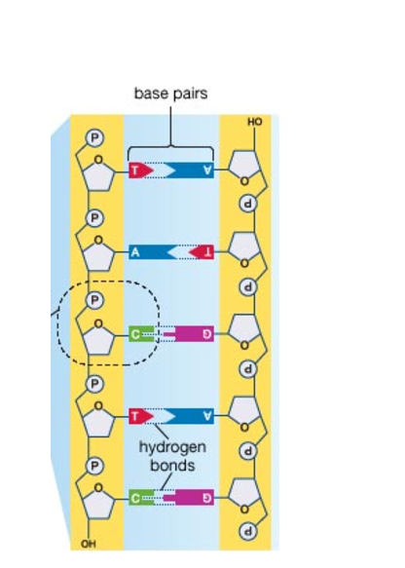
Design of sequencing
3.
DNA
Using dsDNA!

Slide 17
Design of sequencing
3.
DNA

Slide 18
Design of sequencing
3.
DNA

Slide 19
Design of sequencing
3.
DNA

Slide 20
Design of sequencing
3.
DNA
Picture by Tim Noble & Sue Webster

Slide 21
Design of sequencing
3.
DNA
Time to break bond
SHORT
LONG
A
G
SHADOW
BIG
T
C
SMALL

Slide 22
Limitation
>Is it possible to detect continuously?
-How do you distinguish base separation?
-Is there some standard to pass to next base?

