Slide 1
Notes:
Hello everyone my name is ilsun yun. Today I will talk about the molecular mechanism of translation control

Slide 2
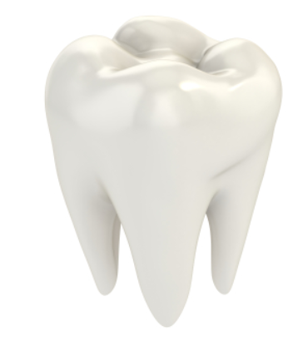
Therapeutic application of tooth regeneration
Ilsun Yun
Notes:
Hello everyone my name is ilsun yun. Today I will talk about the molecular mechanism of translation control

Slide 3
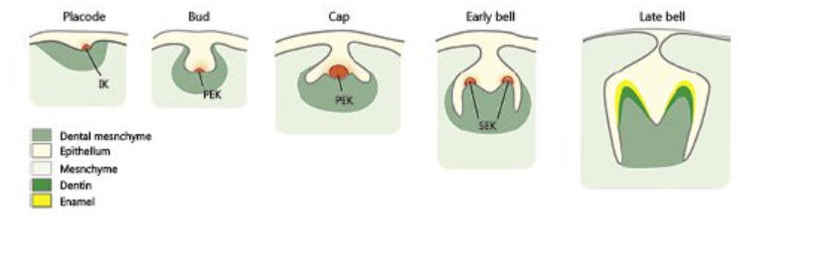
Development of tooth

Slide 4
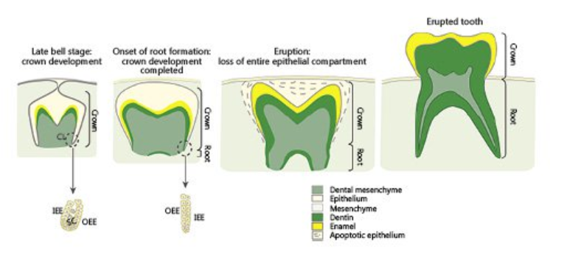
Development of tooth

Slide 5
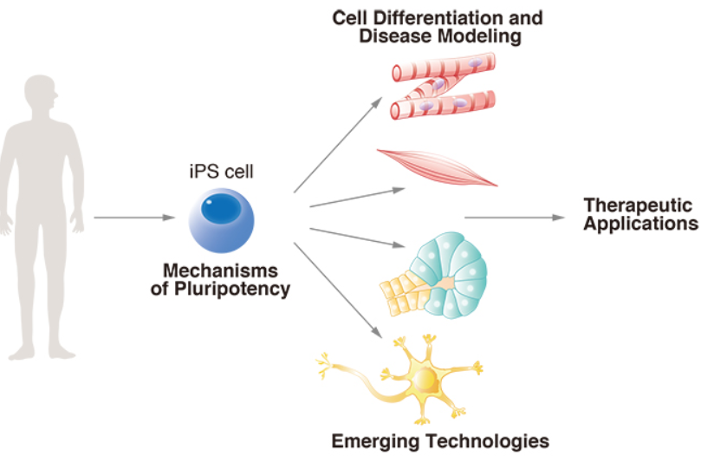
iPS cell

Slide 6
iPS cell designed with tooth tissue

Slide 7
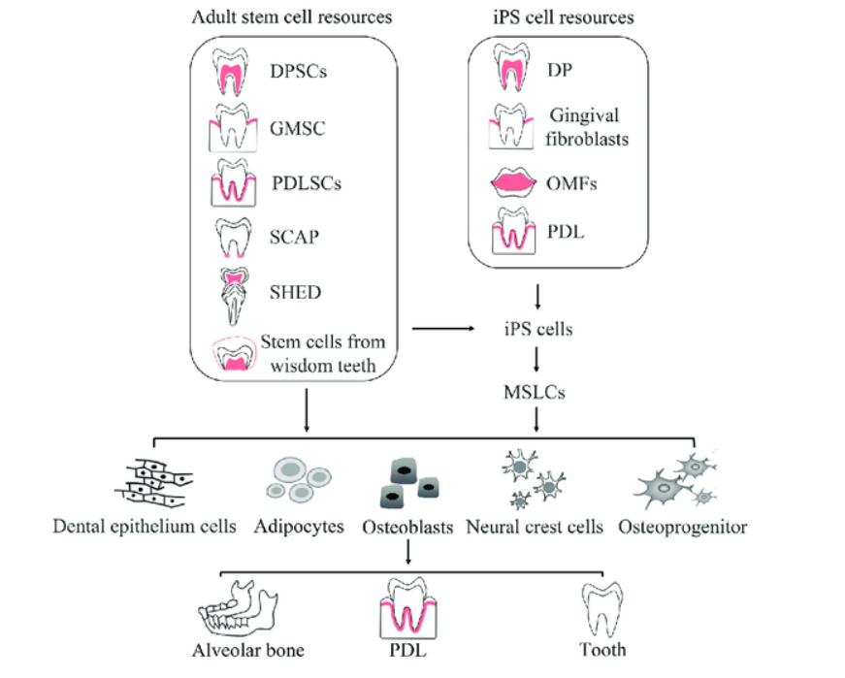

Slide 8
Risk and hurdle
Size and shape
Oncogenic

Slide 9
Q & A
Notes:
Thank you for listening. If you have a question I will answer

