Slide 1
How come that bowhead whale life is long and confer cancer resistances?
Presenter: Madina Seidualy
Student ID: 20132023
Date: 26/11/2016

Slide 2
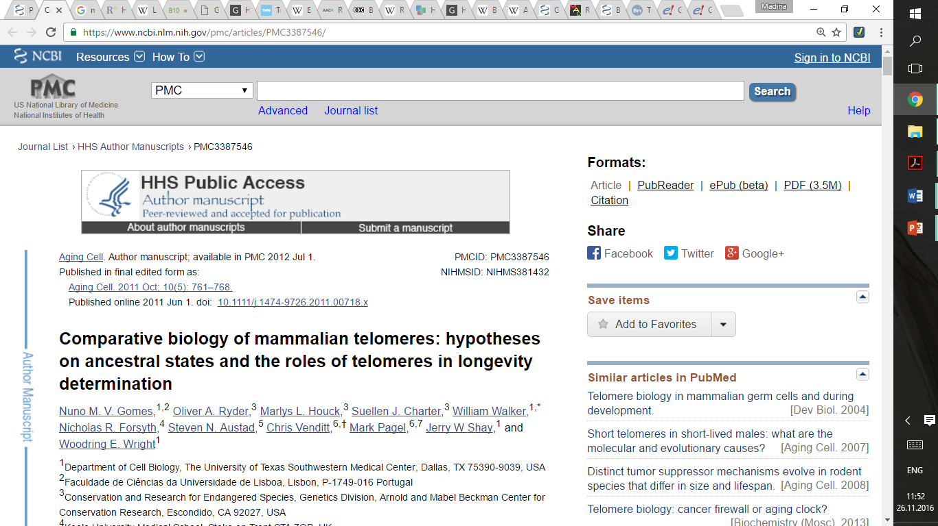
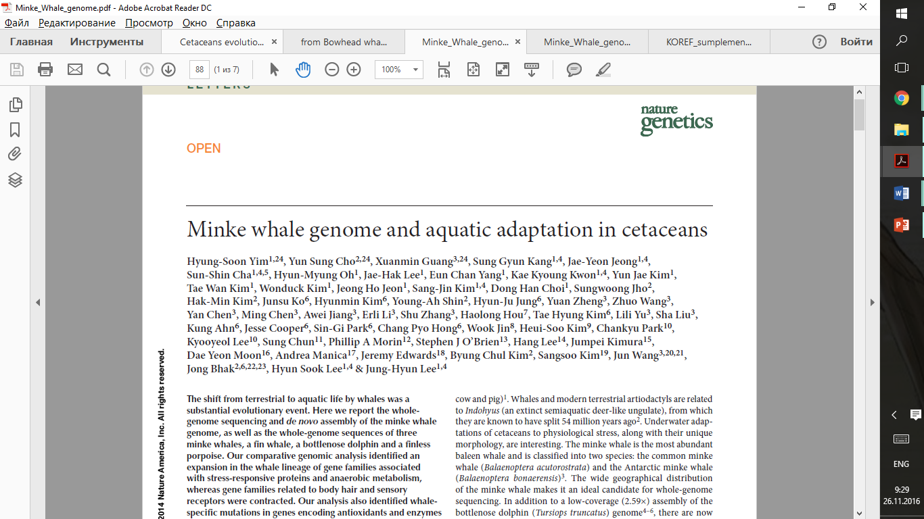

Slide 3
1) Telomerase activity
Eastern Grey Squirrel → At birth, their life expectancy is 1-2 years, an adult typically can live to be six
Madagascar Tenrec → Can live for up to 8 to 10 years
Brown bats → live approximately 6 to 7 years
Tiger → 20-26 years
American Beaver → up to 24 years
Sea lion → 20-30years
Notes:
Evolutionary distribution of telomere length, telomerase activity and stasis (stress or aberrant signaling induced senescence) in the mammalian evolutionary tree. Telomere length, telomerase activity, and stasis induction run in evolutionary clades. Telomere length was measured by terminal restriction fragment (TRF) analysis: Values < 20 kb are shaded black, while values > 20 kb are shaded pink. Nonplacental mammalian orders such as Marsupials and Monotremes show the presence of restriction enzyme recognition sites intercalated between the telomeric (TTAGGG)_{n} sequences and thus are labeled as being of indeterminate size (I). Telomerase activity was detected with TRAP: Values are expressed as a%of the activity in the reference lung adenocarcinoma tumor line H1299, and shaded black if absent and pink if any activity was detected. Stasis: (N) with black shading = cells grew beyond 15 doublings, (Y) with pink shading = cells growth arrested in culture before population doubling 15. Based on these characteristics, some taxonomic orders could be described as exhibiting uniformly human-like telomere phenotypes or having discontinuous telomeres. Arsenite resistance: (Y) with black shading = LD90 > 20 mm sodium arsenite after 4 h exposure, (N) with pink shading = LD90 < 5 mm

Slide 4
No strict Relationship of telomeres and telomerase to mass and lifespan
Life span
Telomerase activity
Telomere length
Body mass

Slide 5
2) Hypoxia condition
Most marked environmental adaptation for a whale is deep diving, which induces hypoxia
Anaerobic metabolism-glycolysis
Glucose + 2ADP + 2P_{i →} Lactate + 2ATP + 2H₂O
O₂ an electron acceptor in aerobic metabolism
Glucose + 6O₂ + 36ADP + 36P_{i →} 6CO₂ + 36ATP + 6H₂O
Notes:
Cancer need more energy, so use 36 ATP, but there is no O2 in cells

Slide 6
2) Hypoxia condition

Slide 7
Expansion of the lactate dehydrogenase A (LDHA) homolog genes in the whale lineage and naked mole rat. LDHA was expanded in the minke whale (3 copies), bottlenose dolphin (2 copies), and naked mole rat (4 copies)
Notes:
In whales, blood lactate concentration increases after prolonged diving, and hypoxia is known to control lactate concentration by activating hypoxia-inducible factor. Lactate dehydrogenase (encoded by LDH) is the enzyme responsible for converting pyruvate to lactate. In our analysis, we found that the LDHA homolog genes had undergone an expansion in mammals that are known to live under hypoxic conditions, namely whales and naked mole rats

Slide 8
Bowhead whale have distinctive angiogenesis process or difference in protein sequence help them control hypoxia condition differently.
Notes:
This protein have gene match only with human and cow gene, not minke whale
And dN/dS = ratio close to 1, which means positive selection.

Slide 9
Bowhead whale & minke whale
Even though the minke whale is the closest relative to the bowhead (divergence time 25–30 million years ago)
High level of sequence conservation in the protein coding: 96% (minke)
Minke whale is smaller <10 tons
shorter lived → maximum lifespan 50 years
Bowhead whale is 74 to 98 long tons
long lived → lifespan up to 200 years

Slide 10
In that 4% differences hidden longevity and anti-aging miracles of the bowhead whale
Especially, we have to look every nucleotide and amino acid sequencing differences in DNA repair proteins and angiogenesis proteins structures.

Slide 11
Thank you for attention

